Slide 1
Systematic mapping
Selsabil dbouba, khaled fayala,
constantin masson, Maxime gallais-jimenez

Slide 2
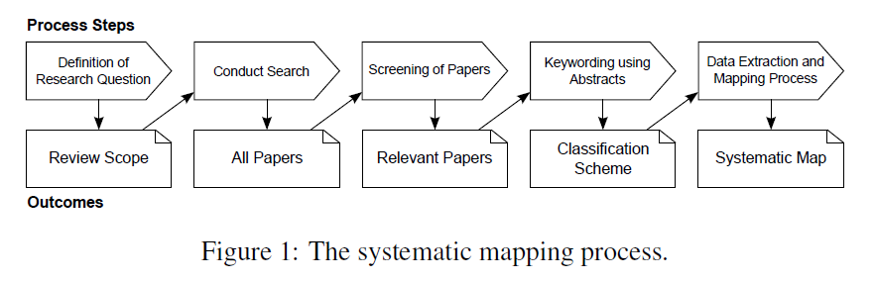
Introduction

Slide 3
Hypothèses de recherche
RQ1 : Quels sont les critères d’une utilisabilité efficace d’API ?
RQ2 : Comment améliorer l’utilisabilité d’une API ?

Slide 4
Choix des mots clés
API | Usability
API Software Library Application Programming Interface | Usability ISO 9241 Ease-of-use
Requête :
TITLE-ABS-KEY((((‘’API’’)
OR (‘’Software library’’)
OR (‘’Application Programming Interface’’))
AND ((‘’usability’’)
OR (‘‘ISO 9241’’)
OR (‘’ease ?of ?use’’))
OR (‘’API us*’’)

Slide 5
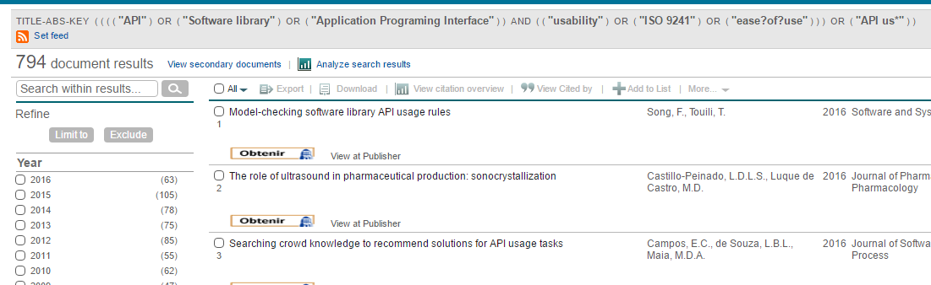
Résultats avant filtrage
794 documents obtenus

Slide 6
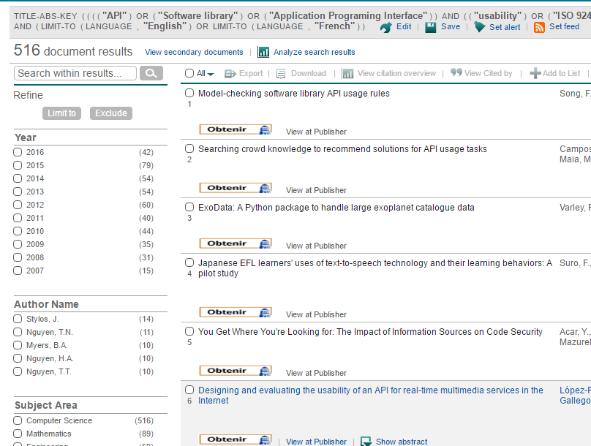
Requête avec filtres
Requête :
TITLE-ABS-KEY((((‘’API’’)
OR (‘’Software library’’)
OR (‘’Application Programming Interface’’))
AND ((‘’usability’’)
OR (‘‘ISO 9241’’)
OR (‘’ease ?of ?use’’))
OR (‘’API us*’’)
AND (LIMIT-TO(SUBJAREA, ‘’COMP’’))
AND (LIMIT-TO(LANGUAGE, ‘’English’’)
OR LIMIT-TO (LANGUAGE, ‘’French’’)
516 documents obtenus

Slide 7
Screening
Papiers validés | Papiers rejetés | Papiers ambigus | Papiers gardés
56 | 196 | 253 | 73

Slide 8
Plan de classification
Pour chacun des 73 articles des tags ont été mis
30 tags différents dans différentes catégories
Type d’étude (étude de cas, comparative, empirique, théorique…)
Aspect étudié (documentation, évaluation, mesure…)
Outil utilisé (framework, test unitaire…)
Technique utilisée (dscussion, enquête, entrevue, rencontre…)

Slide 9
Conclusion
A suivre…

Slide 10
A Case Study of Web API Evolution
A case study of API redesign for improved usability
A cooperative approach for combining client-based and library-based API usage pattern mining
A dataset for API usage
A framework for extending usability engineering: API usability essentials: Extending usability via component-based platform
A study of modern Linux API usage and compatibility: What to support when you're supporting
ACUA: API change and usage auditor
An API design process in terms of usability: A case study on building more usable apis for smart TV platform
An exploratory study of API usage examples on the web
An observational study on API usage constraints and their documentation
API peer reviews: A method for evaluating usability of application programming interfaces
API usability peer reviews: A method for evaluating the usability of application programming interfaces
API usability: CHI'2009 special interest group meeting
Applying the cognitive dimensions of API usability to improve API documentation planning
Approximate structural context matching: An approach to recommend relevant examples
An empirical comparison of static and dynamic type systems on API usage in the presence of an IDE: Java vs. Groovy with eclipse
An empirical study of API usability
An exploratory study of api changes and usages based on apache and eclipse ecosystems
Automated measurement of API usability: The API Concepts Framework
Automatic evaluation of API usability using complexity metrics and visualizations
Automatic parameter recommendation for practical API usage
Approximate structural context matching: An approach to recommend relevant examples
Building more usable APIs

Slide 11
Constructing usage scenarios for API redocumentation
Context-sensitive code completion tool for better API usability
CriticAL: A critic for APIs and libraries
Designing and evaluating the usability of an API for real-time multimedia services in the Internet
Detecting inefficient API usage
Evaluating the reference and representation of domain concepts in APIs
Generating API-usage example for project developers
Improving API documentation usability with knowledge pushing
Improving API documentation using API usage information
Improving API usability
Influence of code completion methods on the usability of APIs
Influencing factors on the usability of API classes and methods
Informing API design through usability studies of API design choices: A research abstract
Linking usage tutorials into API client code
MAPO: Mining API usages from open source repositories
Mapping the space of API design decisions
Measurable concepts for the usability of software components
Measuring API Usability
Methods towards API usability: A structural analysis of usability problem categories
Mining API patterns as partial orders from source code: From usage scenarios to specifications
Mining API usage examples from test code
Mining API usage patterns by applying method categorization to improve code completion
Mining multi-level API usage patterns
Neural networks for sentiment analysis on Twitter
Obstacles in using frameworks and APIs: An exploratory study of programmers' newsgroup discussions
Prose + test cases = specifications

Slide 12
Recommending API usages for mobile apps with hidden Markov model
Recommending posts concerning API issues in developer Q&A sites
Recommending proper API code examples for documentation purpose
Recommending reference API documentation
Searching the State Space: A Qualitative Study of API Protocol Usability
Some structural measures of API usability
Statistical learning approach for mining API usage mappings for code migration
Synthesizing API usage examples
Temporal analysis of API usage concepts
The API walkthrough method: A lightweight method for getting early feedback about an API
The concept maps method as a tool to evaluate the usability of APIs
The factory pattern in API design: A usability evaluation
The implications of method placement on API learnability
The role of conceptual knowledge in API usability
Type names without static type checking already improve the usability of APIs (As Long as the Type Names are Correct): An Empirical Study
Unit tests as API usage examples
Usability evaluation of configuration-based API design concepts
Usability implications of requiring parameters in objects' constructors
Usability of educational technology APIs: Findings and guidelines
Usable results from the field of API usability: A systematic mapping and further analysis
Useful, but usable? Factors affecting the usability of APIs
Using concept maps to evaluate the usability of APIs
Visualization based API usage patterns refining
What makes APIs hard to learn? answers from developers

